Slide 1
Interpretation, Hypothesis Testing and Model Fit
Jacob LaRiviere
(some content from Justin Rao)

Slide 2
Outline
Interpretation of Coefficients
Hypothesis Testing
Model Fit

Slide 3
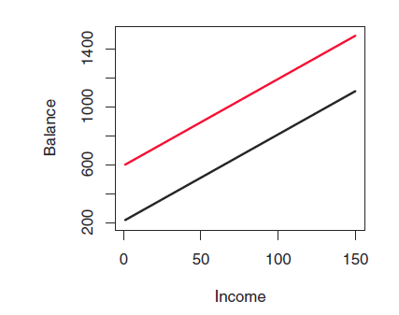

Understand binary features
$β_{1}$ allows for a different y-intercept for students
$$y_{i}=α+β_{1}\{1 if student\}+β_{2}income+ε_{i}$$

Slide 4
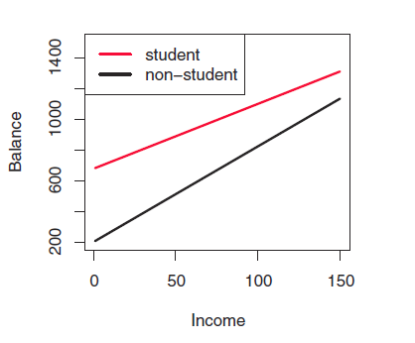

Understand binary features
$β_{1}$ allows for a different
y-intercept for students
$β_{3}$ allows for a different
Slope for students
$$y_{i}=α+β_{1}\left\{1 if student\right\}+β_{2}income+β_{3}\left\{1 if student\right\}∗income+ε_{i}$$

Slide 5
Interaction terms
Interaction term: multiplying two features by each other. When done as such:
{continuous feature}*{binary feature}
it allows for a different slope for the group represented by the binary feature. Note, be sure to include the continuous feature without the interaction as well.
Example, suppose temperature has a different impact on # of bikeshare trips taken on weekdays vs. weekends. We can create a binary variable is_weekend.
If we add is_weekend to the model, we allow for a different baseline ridership on weekends. If we add is_weekend*temp, we allow temperature to have a different effect for weekends.
We can “interact” is_weekend with a polynomial in temp. This effectively gives us a new model for temperature for the weekends vs. weekdays

Slide 6
Conditioning on Socio-demographics
Think about two different models:
reg1 = glm(logmove ~ log(price)*brand, data=oj)
reg2 = glm(logmove ~ log(price)*brand + HVAL150, data=oj)
reg1 estimates coefficients unconditionally on neighborhood wealth “proxy”
reg2 estimates coefficients conditioning on neighborhood wealth “proxy”
NOTE 1: What if prices are set higher in richer neighborhoods and richer neighborhoods consume more OJ? The coefficient on price is a mix of the price effect and the wealth effect!
NOTE 2: Proxy isn’t the perfect thing to measure wealth (average assets of HHs)

Slide 7
Interpreting regression output
Summary(my_model) gives the coefficient estimates (beta’s), t-statistics, standard errors and p-values.
t-statistics evaluate the hypothesis that the coefficient is equal to zero. Thus t greater than 1.96 in absolute value allows us to reject this hypothesis at the 95% level.
P-values simply convert t-stats into the probability we would get something this far from zero due to sampling chance alone.
NOTE 1: t-statistics evaluate features “one by one”. Overall model fit is a better guide for explanatory power (e.g. we might be better for leaving insignificant features in sometimes)
NOTE 2: t-stats can be a good guide to throw out irrelevant features

Slide 8


How does this work for inference?
What about hypothesis testing? (Now assume $α≠0$)
$$se(\hat{β})=\sqrt{{\hat{σ}}_{\hat{β_{1}}}^{2}/n}$$
$$∝\frac{\frac{1}{n−2}\sum_{i=1}^{n}{(x_{i}−\overline{x}})2 \hat{ε_{i}}2}{\sum_{i=1}^{n}{(x_{i}−\overline{x}})2}$$
$$→t=\frac{{\hat{β}}_{1}−β_{1,0}}{se(\hat{β})}$$
Both of these are themselves sample statistics from data y and X. Remember ${\hat{β}}_{1}$ is As a result, they both have their own distributions (e.g., normal and Chi Squared). The resulting ratio has the Student t distribution which is used for hypothesis testing for a given sample.

Slide 9
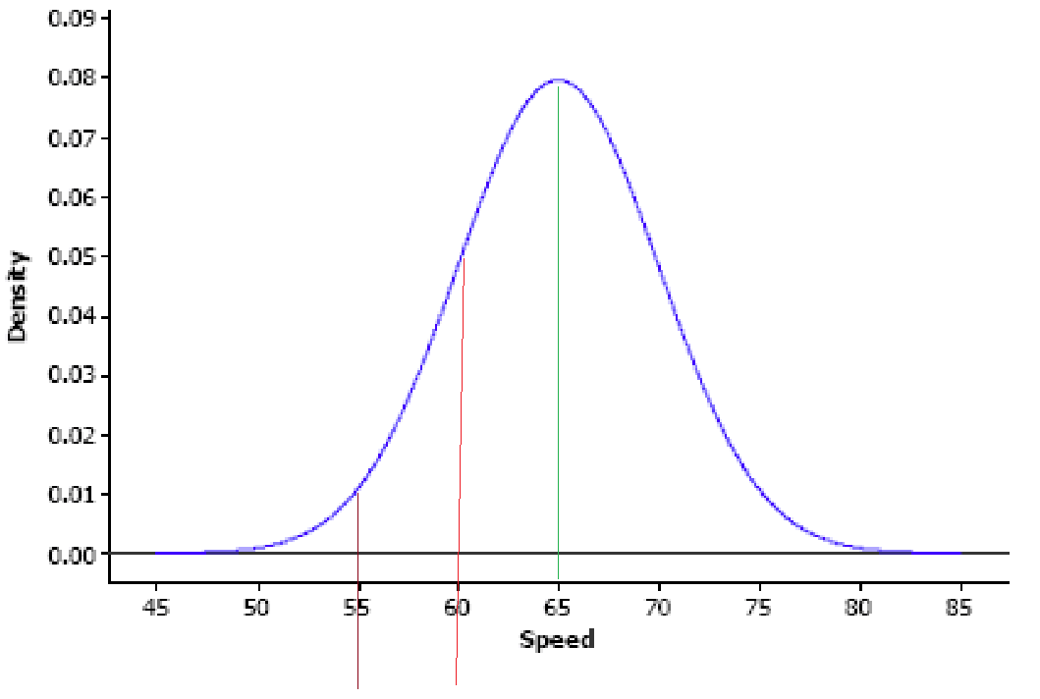
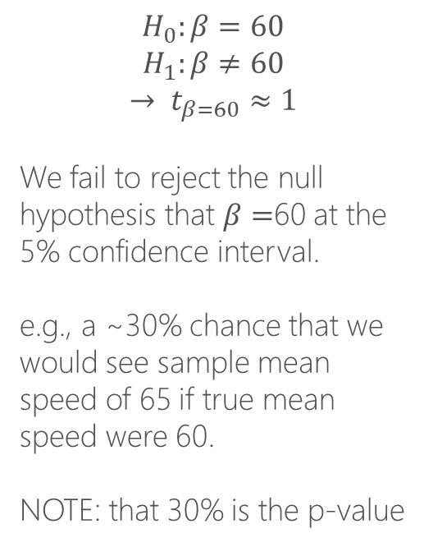
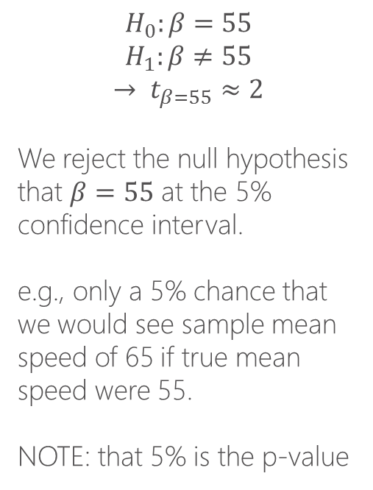


How does this work for inference?
What about hypothesis testing? What is t-stat of different hypotheses given a sample size, variance in the data, and therefore the standard error?
$$H_{0}:β=60$$
$$H_{1}:β≠60$$
$$→ t_{β=60}≈1$$
We fail to reject the null hypothesis that $β=$60 at the 5% confidence interval.
e.g., a ~30% chance that we would see sample mean speed of 65 if true mean speed were 60.
NOTE: that 30% is the p-value
$$H_{0}:β=55$$
$$H_{1}:β≠55$$
$$→ t_{β=55}≈2$$
We reject the null hypothesis that $β=55$ at the 5% confidence interval.
e.g., only a 5% chance that we would see sample mean speed of 65 if true mean speed were 55.
NOTE: that 5% is the p-value
$$t_{β=55}≈2$$
$$t_{β=60}≈1$$

Slide 10
How does this work for inference?
What about hypothesis testing? What is t-stat of different hypotheses given a sample size, variance in the data, and therefore the standard error?
Words to the wise:
If you have a really small data set the standard errors will be big. Thus its hard to reject hypothesis.
If you test a bunch of hypotheses, things get more complicated.
This is about hypothesis testing not model prediction.
$$t_{β=55}≈2$$
$$t_{β=60}≈1$$

Slide 11
How does this work for inference?
Lets test a hypothesis:
Does price sensitivity increase as neighborhoods increase in wealth?

Slide 12
Model Fit

Slide 13
Hypothesis Testing versus Prediction
In certain scientific applications we often want to do hypothesis testing
In others we might care about prediction. These are often “researcher as engineer” scenarios.
e.g., Kleinberg et. al. 2017.
Who reoffends while out on bail?

Slide 14
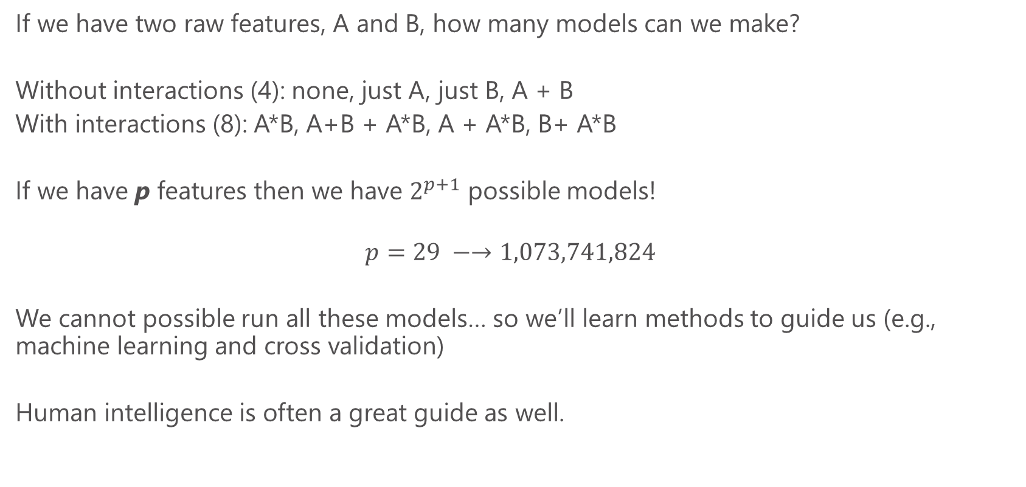
Feature explosion
If we have two raw features, A and B, how many models can we make?
Without interactions (4): none, just A, just B, A + B
With interactions (8): A*B, A+B + A*B, A + A*B, B+ A*B
If we have p features then we have $2^{p+1}$ possible models!
$$p=29 −→1,073,741,824$$
We cannot possible run all these models… so we’ll learn methods to guide us (e.g., machine learning and cross validation)
Human intelligence is often a great guide as well.

Slide 15
Cross Validation & Model Selection
If we have two raw features, A and B, how many models can we make?
Without interactions (4): none, just A, just B, A + B
With interactions (8): A*B, A+B + A*B, A + A*B, B+ A*B
If we have p features then we have $2^{p+1}$ possible models!
$$p=29 −→1,073,741,824$$
We cannot possible run all these models… so we’ll learn methods to guide us (e.g., machine learning and cross validation)
Human intelligence is often a great guide as well.

Slide 16
Validation set methodology
Train the model with a subset of the data
Test the model on the remaining data (the validation set)
What data to choose for training vs. test?
In a time-series dimension, it is natural to hold out the last year (or time period) of the data, to simulate predicting the future based on all past data. In most settings, however, we’ll randomly select our training/test sets.

Slide 17
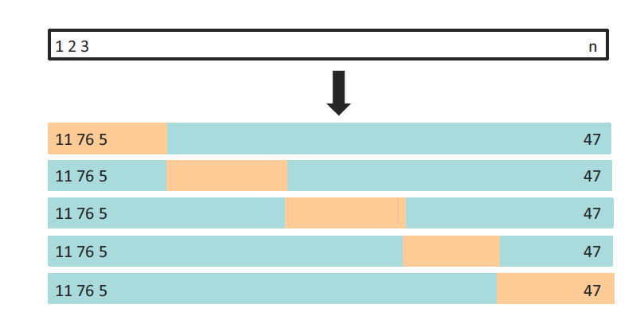
Cross-validation
A class of methods to do many training/test splits and average over all the runs
Here is a simple example of 5-fold cross validation. Gives 5 test sets → 5 estimates of MSE.
The 5-fold CV estimate is obtained by averaging these values.

Slide 18
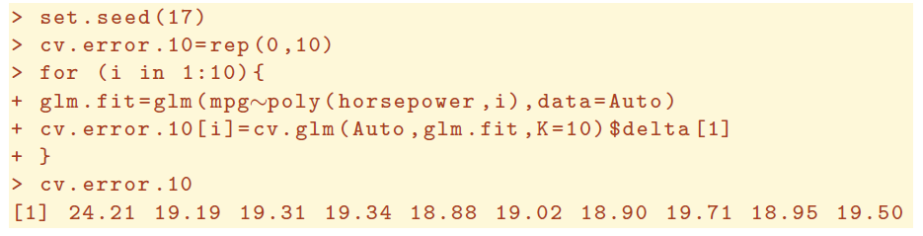
K-fold cross-validation
Split the data up into K “folds”. Iteratively leave fold k out of the training data and use it to test.
The more folds, the smaller each testing set is (more training data), but the more times we need to run the estimation procedure. Using rules of thumb like 5—10 folds is often utilized in practice. This can be done with a simple for loop in R
For generalized linear models, the cv.glm() function can be used to perform k-fold cross validation. For example, this code loops over 10 possible polynomial orders and computes the 10-fold cross-validated error in each step

Slide 19
K-fold cross-validation
Split the data up into K “folds”. Iteratively leave fold k out of the training data and use it to test.
Lets do an example with the Orange Juice data:
Should we include socio-demographic characteristics or not if we care about predicting sales and order inventory.
Lets do an example.

Slide 20
Parametric versus Non-parametric Models

Slide 21
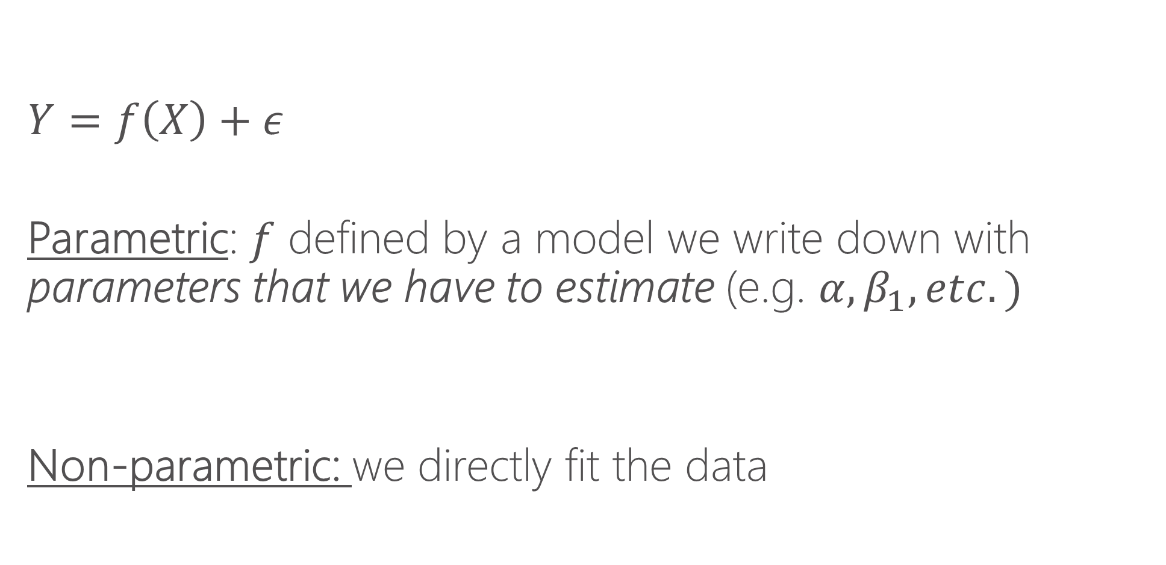
Parametric vs. non-parametric regression
$$Y=f\left(X\right)+ε$$
Parametric: $f$ defined by a model we write down with parameters that we have to estimate (e.g. $α, β_{1}, etc.)$
Non-parametric: we directly fit the data

Slide 22
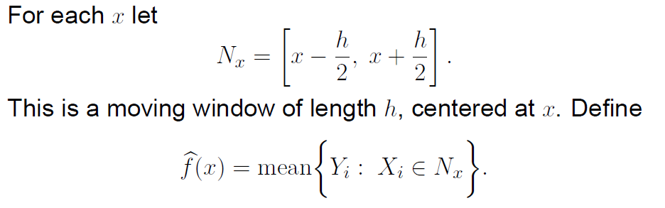
Local averaging

Slide 23
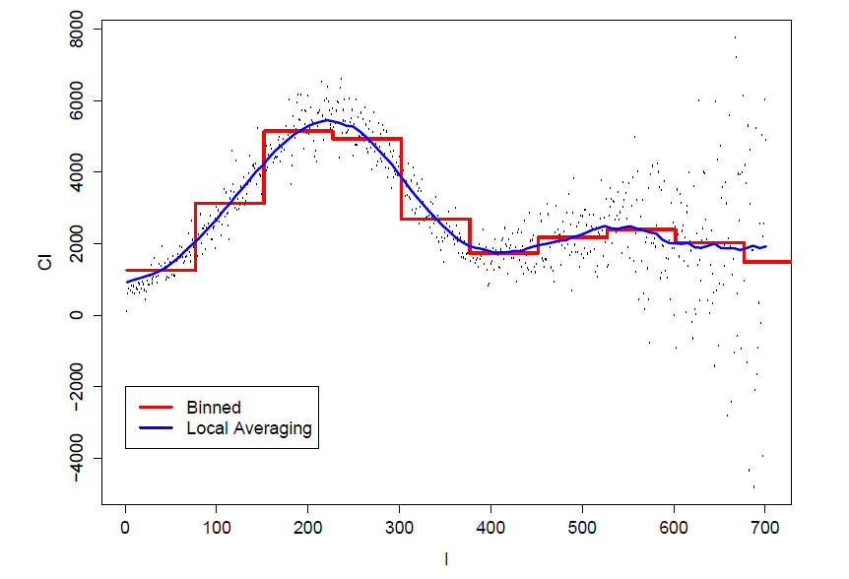
Local averaging vs. bins

Slide 24
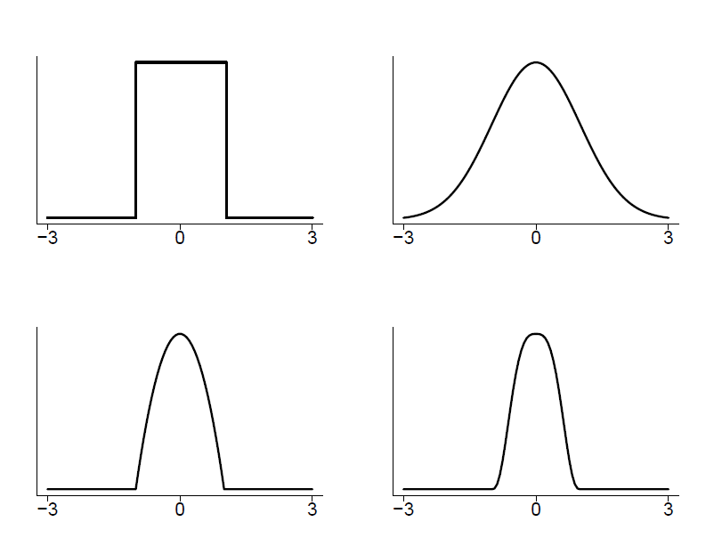
Kernels
A method of assigning higher weight to the points closer to the target point I am trying to fit.
Choice of kernel usually does not matter much.

Slide 25
Bandwidths
Bandwidths tell us how wide to make our kernel (window)
Larger bandwidths → smoother functions because there is more data used to make the averages
Bandwidth is sometimes called the smoothing parameter.
Bandwidths matter!

Slide 26
K-nearest neighbors
An alternative to bandwidths is instead of specifying a fixed window, we can say “use the nearest K nearest neighbors”
This ensures each bin has the same amount of data and can be a useful tool
Functionally it will often be quite similar to using a bandwidth, except when there are “sparse data” issues (then K-NNN is preferred)
Often expressed as a fraction of data. E.g. NN=.1 says “each bin is 10% of data”

Slide 27
Local polynomial regression
Thing of local averaging as fitting a constant for a given window of data
Instead of fitting a constant, we can fit a line (y=a*x + b) or a polynomial (y=a*x + b*x^2 + c), etc.
It is thus more general than local averaging, but very similar

Slide 28
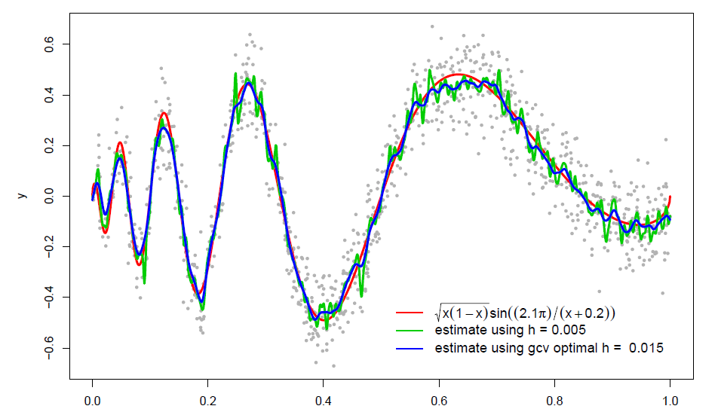
Some examples

Slide 29
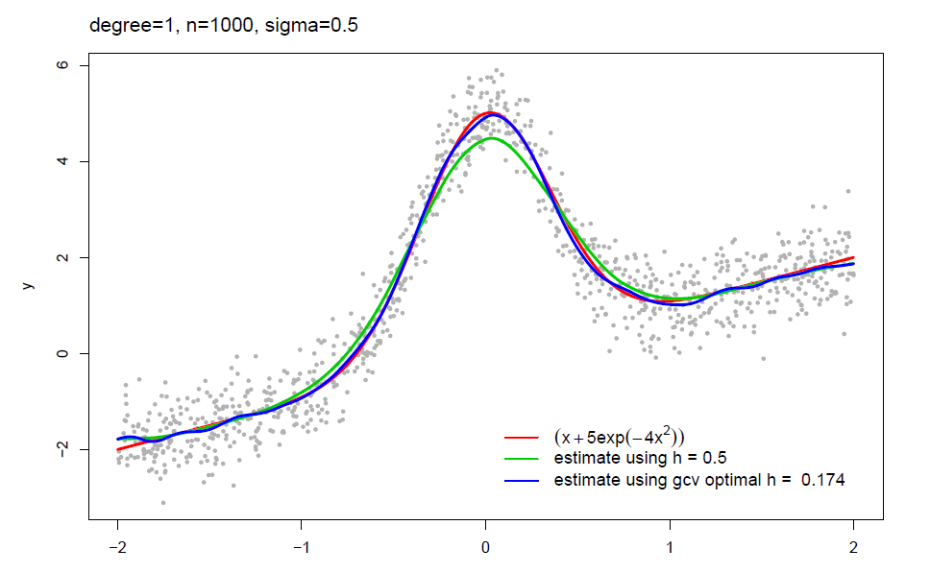
Some examples

Slide 30
Local polynomial in R locfit install.packages(locfit) library(locfit) Modeler needs to specify: bandwidth (or fraction of nearest neighbors), degree of the local polynomial Contrast: in parametric regression, we had to write down a model Aside: we’ll learn that non-parametric methods struggle in higher dimensions

Slide 31
When to use each model?
If there are a relatively small number of features (e.g. <4) then non-parametric makes a lot of sense.
With many features, the “curse of dimensionality” sets in and non-parametric methods fall apart (the “neighborhood” is generally empty)
Parametric models using interaction terms and polynomials are the preferred method with many features
“Semi-parametric” methods combine elements of both

